Slide 1
Retrieval Augmented Generation

Slide 2

Why using RAG ?
1
Up-to-date Information & Reduce Information
2
Domain Adaptation and Customization
3
Control and Transparency

Slide 3
Retrieval Augmented Generation Phases
1
2
INGESTION
RETRIEVAL

Slide 4
Ingestion Phase
-----------
--------------
------------
-----------
--------------
------------
-----------
--------------
------------
-----------
Index
Embeddings
--------------
------------
-----------
--------------
------------
-----------
--------------
------------
1
2
3
4
Documents
Chunks
Vectorization
Vector DB

Slide 5

Retrieval
Index
Query
Embeddings
Top K Results
3
1
2
------------
+
--------------
Query
------------
4
Augmented prompt
--------------
-----------
LLM Response
6
5
LLM Inference

Slide 6
Re-Ranking
Re-rankers types: Cross-encoder, Multi-vector, LLM
Index
3
Top K Results
Query
------------
------------
--------------
Re-Ranker
--------------
+
Query
------------
------------
--------------
--------------
-----------
4
-----------
5
LLM Inference

Slide 7
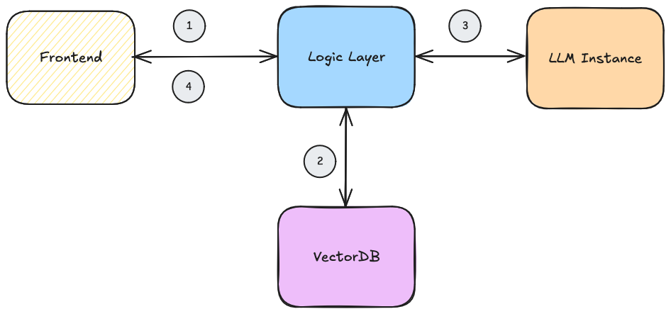
Architecture Example (running phase)
I don’t want to retrieve data every time I talk to my LLM. How can I do ?

Slide 8
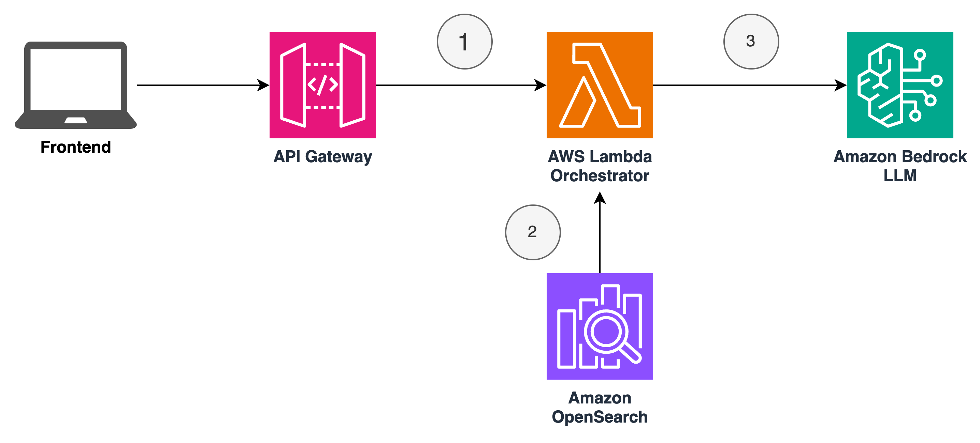
Architecture Example (running phase)
Caveats
API Payload limitations
Top K tradeoff
Concurrent execution, quotas limites
*this is a simplified architecture

Slide 9
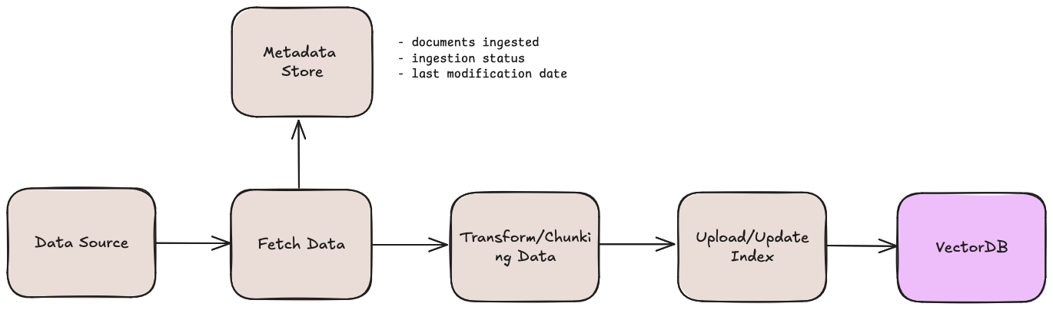
Architecture Example (Ingestion)

Slide 10
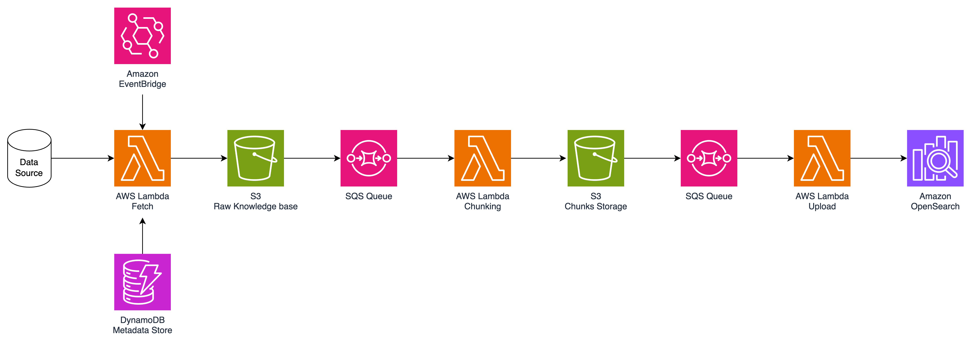
Architecture Example (Ingestion)
Caveats
Payload limitations
VectorDB Throttle
*this is a simplified architecture

Slide 11
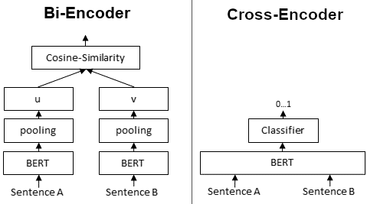
Re-Ranking
Top K Results
Re-ranker
source
Tradeoff between accuracy (cross-encoder) and efficiency (Bi-Encoder)

Slide 12
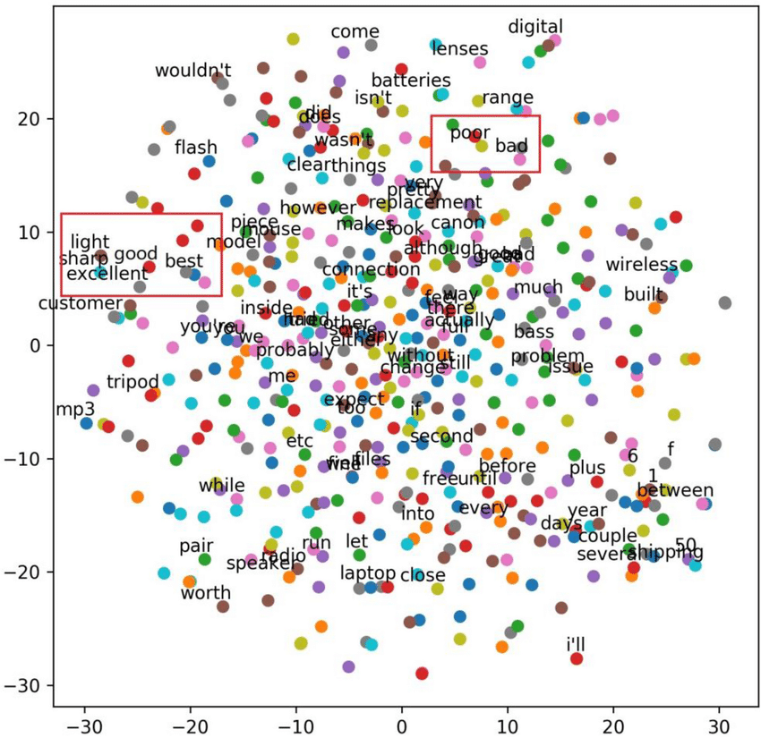

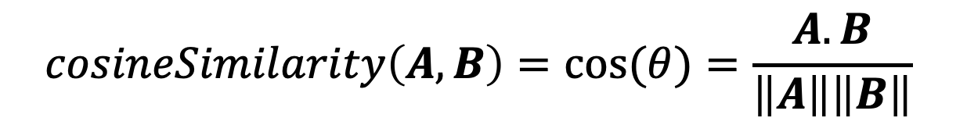


Cosine-Similarity
$$A$$
$$cosineSimilarity\left(A, B\right)=cos⁡(θ)=\frac{A.B}{\left\|A\right\|\left\|B\right\|}$$
$$B$$
$$θ$$
source

Slide 13
Chunking strategy: Fixed-size
overlap
Artificial intelligence is a technology that enables computers and machines to simulate human learning
Chunk 1
Chunk 2
Artificial intelligence is a technology that enables computers and.
that enables computers and machines to simulate human learning

Slide 14
Chunking strategy: Semantic Chunking
Initial First Chunck
-----------
--------------
------------
Segment Doc
(sentence/paragraph)
-----------
--------------
-----------
------------
…
-----------
Keep adding chunks
until cosine drops
--------------
Final Chunks
-----------
-----------
--------------
------------
--------------
--------------
Chunk 1
Chunk 2
Chunk 3

Slide 15



Chunking strategy: Other
Document structure-based chunking
Recursive chunking
LLM Based chunking

Slide 16
Amazon Bedrock Presentation

Slide 17
Exercises

Slide 18

Fine-Tuning

Slide 19
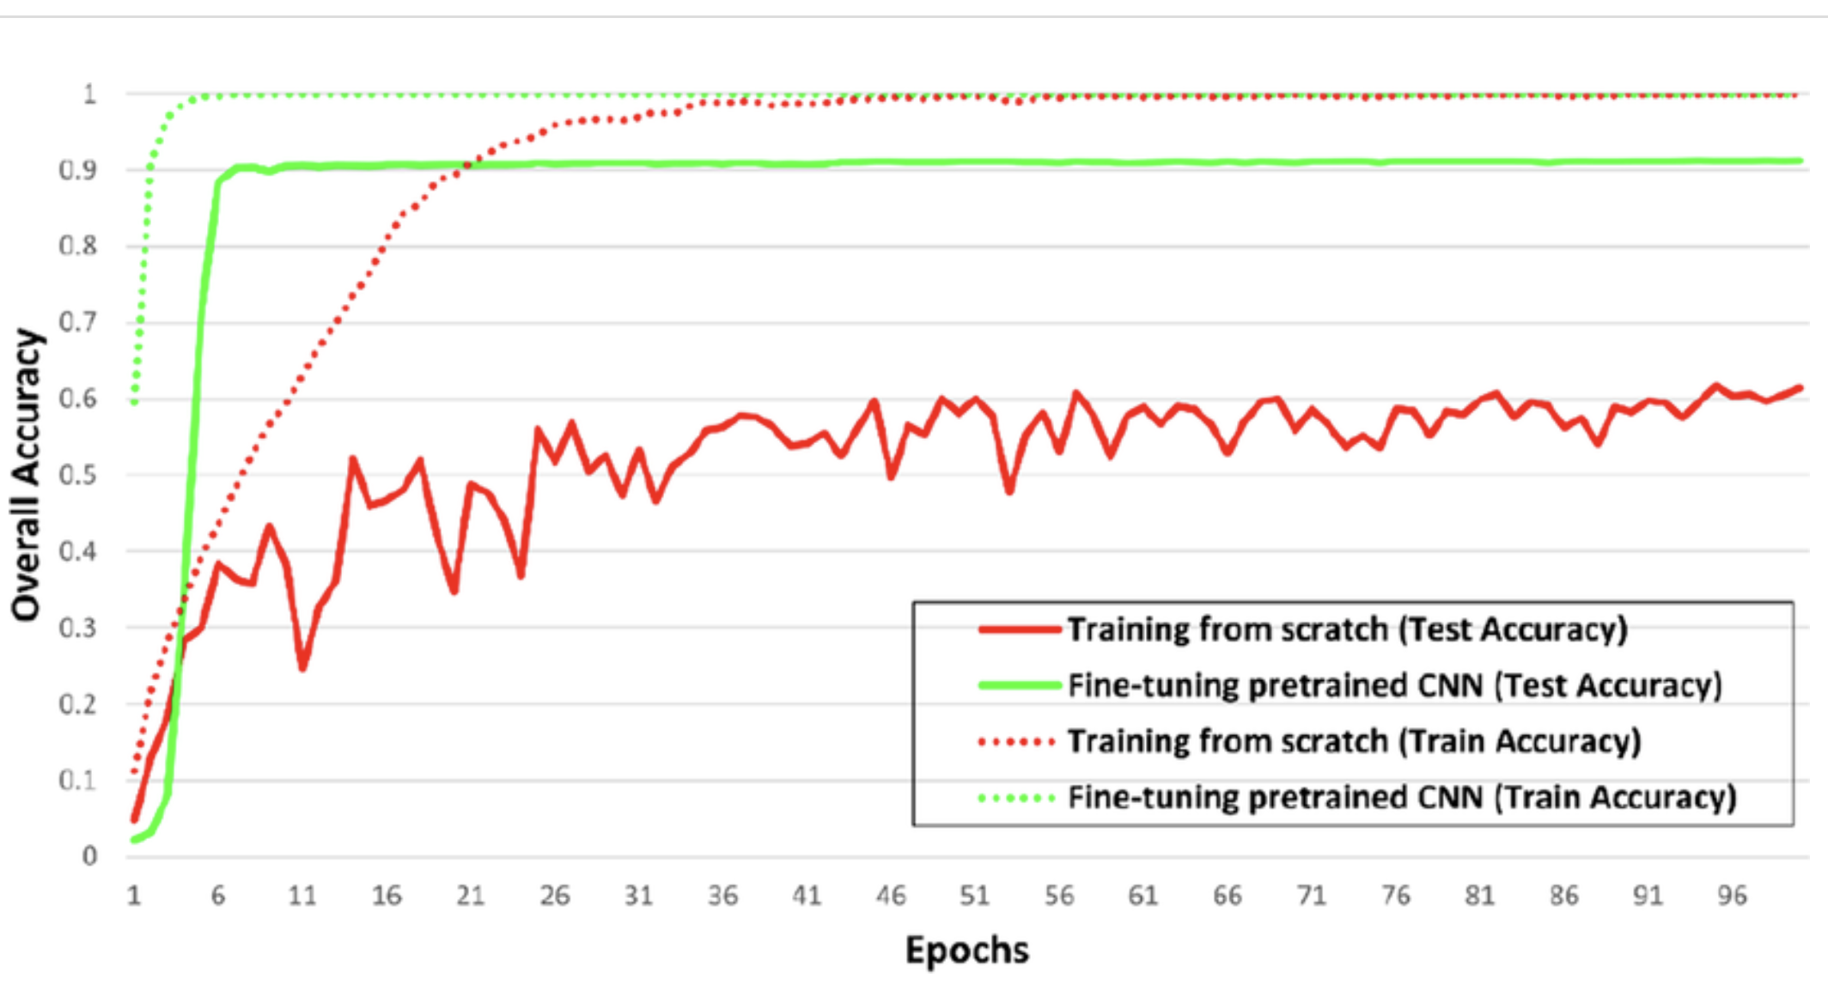
Pretraining vs Fine-tuning
Pretraining: self-supervised learning on vast amount of raw text.
Supervised Fine Tuning: labeled data to train domain-specific application
Training from scratch vs fine-tuning pretrained network (classification)
Source: Snapshot Ensemble‑Based Residual Network (SnapEnsemResNet) for Remote Sensing Image Scene Classification

Slide 20



Pre-trained models
Base models are not answer questions oriented
User: “Write a poem about flowers”
→ They only want to complete the text
Assistant: “ Write poem about summer
Write poem about water…”
Pre-trained models are used as the raw material to build Fine-tuned models for specific use case
Fondation Models

Slide 21
Challenges of Training LLMs models
1 parameter = 4 bytes (32-bit)
1B parameter = 4 GB
+ 8 bytes for Optimizer
+ 4 bytes for Gradient + 8 bytes for Temp Memory
Training requires 6 times more memory than actual size of the mode

Slide 22
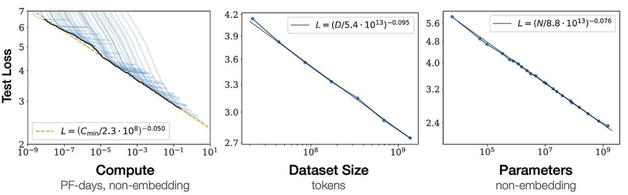
Scaling Law (Chinchilla Scaling Law)
Source: Training Compute-Optimal Large Language Models
Dataset Size = 20 x # Params

Slide 23

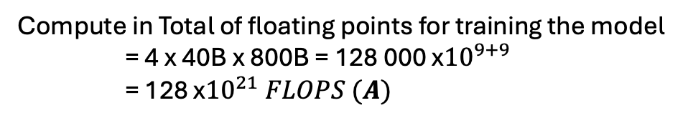
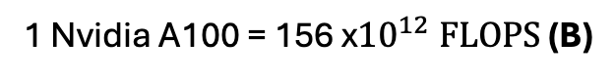
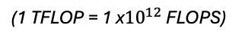
Challenges of Training LLMs models
Example (simplified)
- Llama 40B
Memory Required to train 40B parameter = 6*40 GB = 240GB
(1 single A100 GPU cannot host such model)
Dataset Size = 20 x 40 = 800B Token
Compute in Total of floating points for training the model = 4 x 40B x 800B = 128 000 x${10}^{9+9}$ = 128 x${10}^{21} FLOPS (A)$
(Assuming 4 FLOPs per parameter per token )
1 Nvidia A100 = 156 x${10}^{12} \text{FLOP}S \text{(}\text{B}\text{)}$
(1 TFLOP = 1 x${10}^{12}$ FLOPS)
Total Time to train = A / B = 82 x${10}^{7} seconds=$ 9 490 Days $\sim 26 Years$

Slide 24
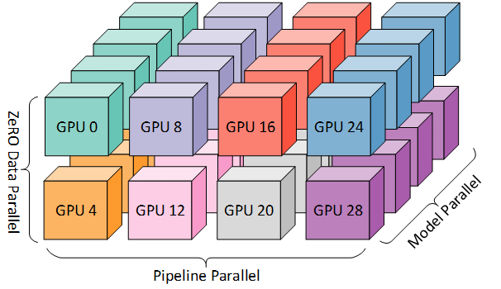
Challenges of Training LLMs models
Example
- Llama 40B
Memory Required to train 40B parameter = 6*40 GB = 240GB
Dataset Size = 20 x 40 = 800B Token
32 Bytes floating point (32 FP)
1 parameter = 4 bytes
16FB
1 parameter = 2 bytes
Parallelization
Quantization
Source: Hugging Face

Slide 25
Scaling Choices for Pre-training
Constraint
Compute Budget
Cost/Time/GPUs
Model Performance
Dataset Size
Model Size

Slide 26

Fine-tuning
Prompt: […], Completion:[…]
Prompt: […], Completion:[…]
Prompt: […], Completion:[…]
Prompt: […], Completion:[…]
Prompt: […], Completion:[…]
Prompt: […], Completion:[…]
Pre-trained LLM
+
Training
Fine-tuned LLM

Slide 27
Fine-tuning
Prompt
LLM Completion
Classify this product review:
“Really bad product”
Sentiment:
Pre-trained LLM
Classify this product review:
“Really bad product”
Sentiment: Neutral
Update All Weights
Expected Completion
Classify this product review:
“Really bad product”
Sentiment: Negative
Loss = Cross-Entropy

Slide 28
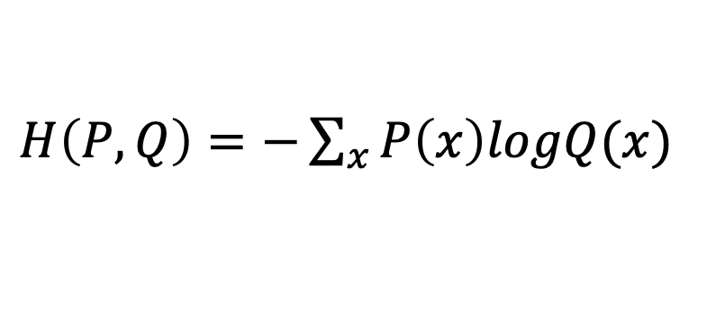
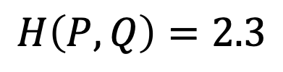
Cross Entropy
$H\left(P, Q\right)=−\sum_{x}{P\left(x\right)logQ(x)}$
P: true distribution of the data
Q: distribution of the model
Example:
0.1
0.1
0.6
0.15
0.05
Q
Pre-trained model output:
$$[ Really, Negative, Negative, Neutral, Positive, Really Positive]$$
0
1
0
0
0
P
Expected output:
$$[ Really, Negative, Negative, Neutral, Positive, Really Positive]$$
$H\left(P, Q\right)=0×\log\left(0.1\right)+0.2×$log(1) + …+ $0×\log\left(0.05\right)$
$$H\left(P, Q\right)=2.3$$

Slide 29
Fine-Tuning Risks
Catastrophic Forgetting : LLM learns better the task you ask it to complete, but then degrades
its performance on non-related tasks
Solutions:
Mutli-task Fine-Tuning
Parameter Efficient Fine-Tuning (PEFT)

Slide 30
PEFT
Original Weights
Additional Weight Layer
Pre-trained LLM
New layer to train on the task

Slide 31
PEFT
Original Weights
Summarize Task Layer
Pre-trained LLM
Pre-trained LLM
+
=
Task: summarize
MB of Weights
QA Task Layer
Pre-trained LLM
Pre-trained LLM
+
=
Task: QA
MB of Weights

Slide 32
PEFT: Low-Rank Adaptation (LoRA)
Standard
Encoder
Self-Attention Layer
Self-Attention Weights
Embeddings

Slide 33
PEFT: Low-Rank Adaptation (LoRA)
LoRA
2 rank decomposition matrices
Encoder
A
B
Self-Attention Layer
+
Self-Attention Weights
A * B
Train the model on these weights
Embeddings

Slide 34
PEFT: Low-Rank Adaptation (LoRA)
Base Transformer Reference Example:
# of weights = 512 (Embedding Size) x 64 (number of layers)
# of weights = 32 769 trainable parameters
With LoRA of rank size r = 8
A = r x 64 = 521 parameters
B = 512 x r = 4 096 parameters
Total Parameters to train = 4 608 trainable parameters
86% less parameters to train

Slide 35
RHLF & Model Evaluation

Slide 36


Definition
RLHF (Renforcement Learning from Human Feedback): is a machine learning approach that combines reinforcement learning with human-provided evaluations or preferences to guide and improve a model's behavior toward desired outcomes.

Slide 37
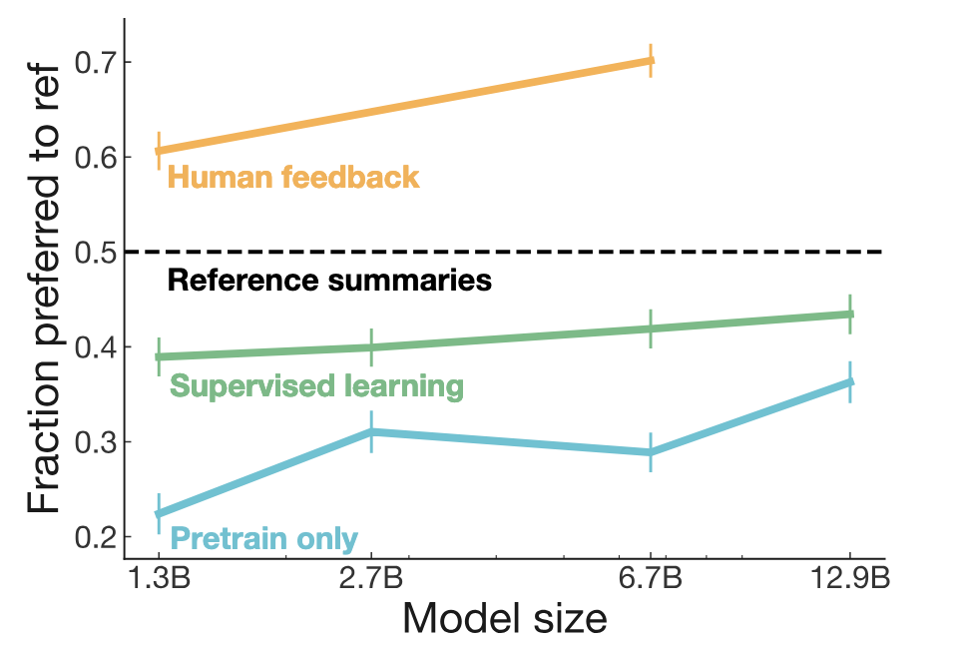
Why RLHF ?
Source: Learning to summarize from human feedback

Slide 38
RLHF
Fine-tuned LLM
Human Aligned LLM
RLHF
Goal : Maximize Helpfuless, Honesty, Harmless

Slide 39

RLHF
Goal : Maximize Helpfuless, Honesty, Harmless
Fine-tuned LLM
(updated by fb)
Update weights
RL Proximal Policy Optimization (PPO) Algorithm
Prompt Dataset
“ A dog is…“
“ …human’s best friends“
Reward model
+2,86
Read about PPO

Slide 40
RLHF – obtaining feedback from human
1. Define your criteria (ex: Helpfulness)
LLM Completion
“ I want to travel learn faster. You can’t do anything about it”
LLM
“ I want to travel learn faster. Read faster”
“ I want to travel learn faster .“
“ I want to travel learn faster. Try to teach someone the topic you learn”

Slide 41
RLHF – obtaining feedback from human
2. Rank Completion base on criteria
LLM Completion
LLL
Prompt Dataset

Slide 42
RLHF – obtaining feedback from human
2. Rank Completion base on criteria
LLM Completion
1
2
1
2
1
2
…
…
…

Slide 43
RLHF – obtaining feedback from human
2. Train Reward Model
Pairwise comparaison dataset
1
2
1
2
Reward model
Trained Reward model on Criteria
1
2
.
.
.

Slide 44
RLHF
Goal : Maximize Helpfuless, Honesty, Harmless
Fine-tuned LLM
(updated by fb)
Update weights
RL Proximal Policy Optimization (PPO) Algorithm
Prompt Dataset
“ A dog is…“
“ …human’s best friends“
Reward model
+2,86
Stopping Criteria:
# iterations
Success criteria
Read about PPO

Slide 45
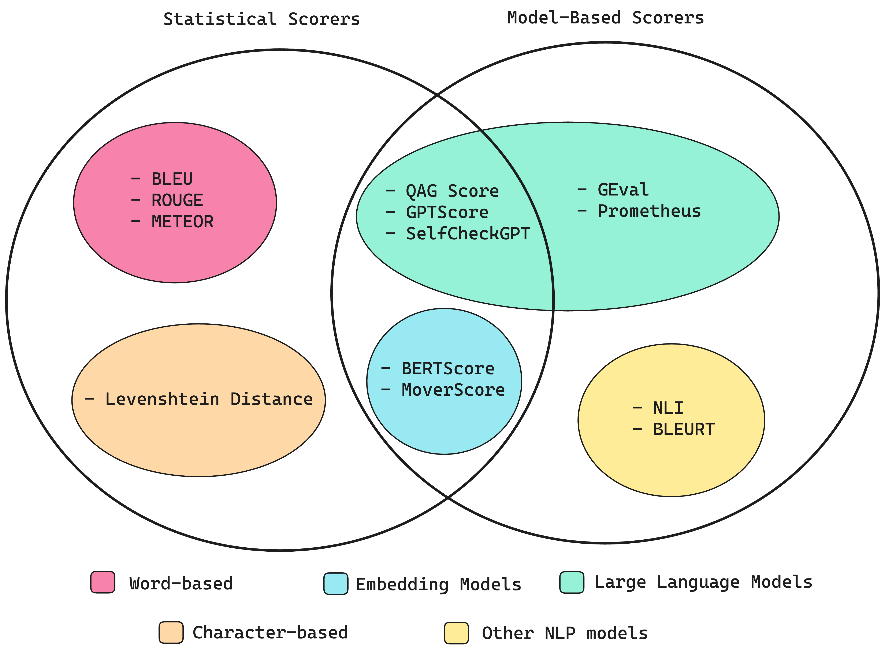
LLM Evaluation
Source: confident-ai

Slide 46
Statistical Scores
1. ROUGE & BLEU Score
Rouge
BLEU
Text summarization
Text Translation

Slide 47
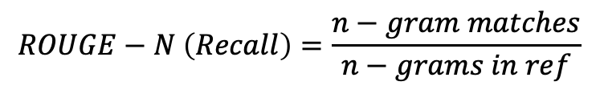
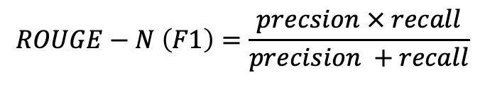
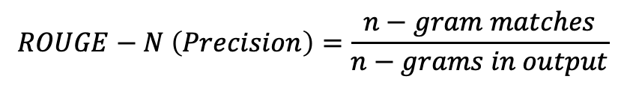
Statistical Scores
1. ROUGE & BLEU Score
$$ROUGE−N \left(Recall\right)=\frac{n−gram matches}{n−grams in ref}$$
Rouge
$$ROUGE−N \left(Precision\right)=\frac{n−gram matches}{n−grams in output}$$
$$ROUGE−N \left(F1\right)=\frac{precsion × recall}{precision +recall}$$

Slide 48
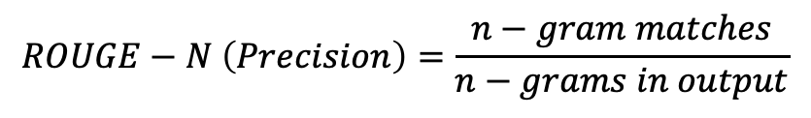
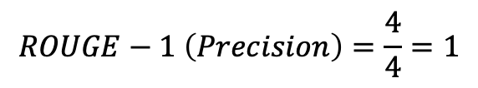
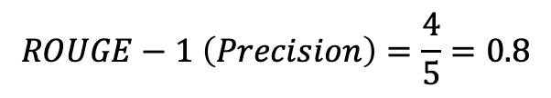
Statistical Scores
$$ROUGE−N \left(Precision\right)=\frac{n−gram matches}{n−grams in output}$$
1. ROUGE & BLEU Score
Reference (human): My name is Toto.
Generated Output:
My first name is Toto
Rouge
$$ROUGE−1 \left(Precision\right)=\frac{4}{5}=0.8$$
! Generated Output:
Toto Toto Toto Toto
$$ROUGE−1 \left(Precision\right)=\frac{4}{4}=1$$

Slide 49
Statistical Scores
1. ROUGE & BLEU Score
BLEU
$$BLEU=avg(precision across range of n−gram sizes)$$

Slide 50
Model Based and Statistical Scores
1. BERTScore
Expected Output
[ Expected Embedding]
Cosine Score
Pre-trained Contextual embedding from BERT model
LLM Output
[ LLM Output Embedding]

Slide 51
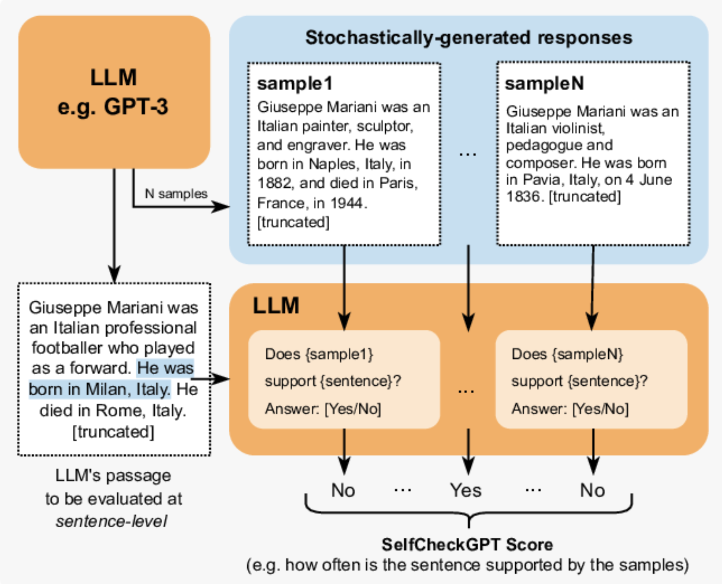
Model Based and Statistical Scores
2. SelfCheckGPT
Source: researchgate

Slide 52
Model Based and Statistical Scores
2. Question Answer Generation - Faithfulness
Prompt: “Who is Christophe Colomb?”
Retrieved Context: ex: (Wikipedia) Chunk 1: His expeditions were the first known European contact with the Caribbean and Central and South America
Chunk 2: completed four Spanish-based voyages across the Atlantic Ocean
LLM Answer: Columbus is a significant historical figure whose voyages had a profound impact on world history,
initiating the Columbian Exchange and European colonization of the Americas.
However, it's important to note that his legacy is complex and controversial
due to the devastating effects his expeditions had on indigenous populations in the Americas.

Slide 53
Model Based and Statistical Scores
2. Question Answer Generation - Faithfulness
Retrieved Context: ex: (Wikipedia) Chunk 1: His expeditions were the first known European contact with the Caribbean and Central and South America
Chunk 2: completed four Spanish-based voyages across the Atlantic Ocean
LLM Answer: Columbus is a significant historical figure whose voyages had a profound impact on world history,
initiating the Columbian Exchange and European colonization of the Americas.
However, it's important to note that his legacy is complex and controversial
due to the devastating effects his expeditions had on indigenous populations in the Americas.
Claim 1
Claim 2

Slide 54
Model Based and Statistical Scores
2. Question Answer Generation - Faithfulness
Retrieved Context: ex: (Wikipedia) Chunk 1: His expeditions were the first known European contact with the Caribbean and Central and South America
Chunk 2: completed four Spanish-based voyages across the Atlantic Ocean
LLM Answer: Columbus is a significant historical figure whose voyages had a profound impact on world history,
initiating the Columbian Exchange and European colonization of the Americas.
However, it's important to note that his legacy is complex and controversial
due to the devastating effects his expeditions had on indigenous populations in the Americas.
Claim 1
Claim 2

Slide 55
Model Based and Statistical Scores
2. Question Answer Generation - Faithfulness
LLM as a Juge
Claim 1
Exists in the context. → OK
Score (ex: 50% Faithfulness)
Claim 2
Doesn’t exist in the context. → NOT OK
LLM Answer: Columbus is a significant historical figure whose voyages had a profound impact on world history,
initiating the Columbian Exchange and European colonization of the Americas.
However, it's important to note that his legacy is complex and controversial
due to the devastating effects his expeditions had on indigenous populations in the Americas.

Slide 56
Model Based and Statistical Scores
3. Answer Relevancy
Prompt: “Who is Christophe Colomb?”
LLM Answer: Columbus is a significant historical figure whose voyages had a profound impact on world history,
initiating the Columbian Exchange and European colonization of the Americas.
However, it's important to note that his legacy is complex and controversial
due to the devastating effects his expeditions had on indigenous populations in the Americas.
“Base on this answer generate possible question that could have resulted to this answer”
LLM
“What legacy did Christophe Colomb gave to Europe ?”
“What did Christopher Colombus colonized?”
“Who is Christopher Colombus ?”

Slide 57

Model Based and Statistical Scores
3. Answer Relevancy
Possible Questions
“What legacy did Christophe Colomb gave to Europe ?”
“What did Christopher Colombus colonized?”
Prompt: “Who is Christophe Colomb?”
“Who is Christopher Colombus ?”
$$×$$
$$Average(CosineSimilarity \left(Possible Questions, Prompt\right))$$

Slide 58


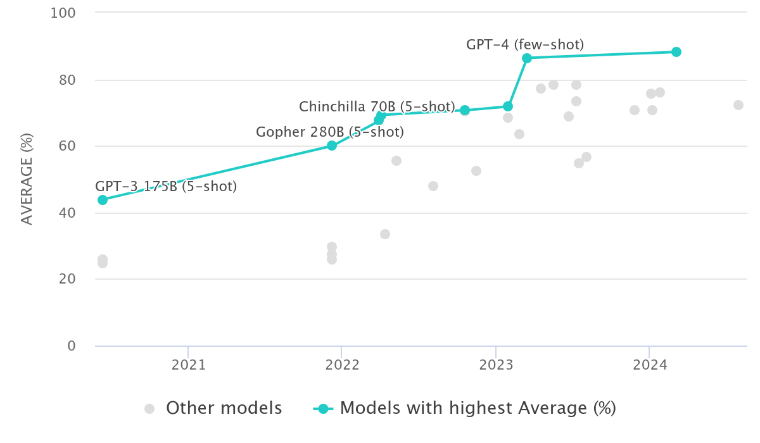
Evaluation Benchmarks
MMLU (Massive Multitask Language Understanding

Slide 59
Agentic AI & System Design

Slide 60


Agentic AI - Definition
Agentic AI: AI systems that are designed to act autonomously to achieve specific goals or complete tasks with minimal human intervention.
Knowledge workers stretched, need productivity tools
LLM’s are powerful, but they can’t take actions
Integration of databases and systems is expensive and slow

Slide 61
Agentic AI - Definition
Agentic AI: AI systems that are designed to act autonomously to achieve specific goals or complete tasks with minimal human intervention.
Knowledge workers stretched, need productivity tools
LLM’s are powerful, but they can’t take actions
Integration of databases and systems is expensive and slow

Slide 62


Agent basics
Agent
Instructions: “you are an agent that …”
do this for me…
Done. Here’s the result…
Actions
Knowledge Bases
62

Slide 63
Simplest agent has only a set of instructions
why did the AI
go to school?
Joke bot
to improve its
learning Rate
Instructions: “you are a funny agent that can only tell jokes. you refuse to do anything else. you always keep the jokes clean and not offensive. you can tell jokes about any topic.”
write an email message
I’m sorry, I’m just a funny bot who tells jokes
63

Slide 64
Agents use actions to get work done
Meeting assistant
list the action items from my meeting
Instructions: “you summarize meetings and send results”
Meeting Actions
Utility Actions
Here are the action items: 1/ …, 2/ …
List Meetings
In: date range
Out: [date, subject, meeting ID]
Send Email
In: subject, recipients, body
Out: status
send them to my team
Get Action Items
In: meeting ID
Out: [action items]
Get Team
Out: list of team member email addresses
Email sent
64

Slide 65
Agents use Knowledge Bases to find information
HR Policy Assistant
Instructions: “you are an HR agent, helping employees understand HR policies”
If I switch to part-time, will I still get vacation days?
HR Knowledge Base
Vacation Policy
Contains the entire vacation policy for the company
Sorry, part-time staff aren’t eligible for vacation days.
65

Slide 66
Agents can combine Actions and Knowledge Bases
HR Policy Assistant v2
how much vacation do I get per year?
Instructions: “you are an HR agent, helping employees understand HR policies and manage vacation time”
as a full-timer with 3 years tenure, you get 15 days
HR Knowledge Base
HR Actions
Vacation Policy
Contains the entire vacation policy for the company
Request Vacation
In: start date, end date Out: approval status, remaining balance
cool. I’d like to take off December 8 to 15
approved, enjoy. you have 8 more days available
66

Slide 67



Agents Workflow
HR Knowledge Base
Existing resources
search-HR-policy
HR Policy docs
Vacation Actions
get-Vacation-Balance
HR Time Off Agent
Vacation microservice
Vacation database
request-LOA
Leave of absence Actions
Leave of absence (LOA) database
67

Slide 68

Agent orchestration – Detailed flow
PROMPT Conversation history Actions, KBs Instructions Task
Step 1
Step 2
…
Step n
Chain of thought
API call
Results
Action Groups
Bedrock
model
Task
Bedrock
Agent
Results
Search
Results
Knowledge Bases
Task + results
Final response
Final response
Bedrock
model
Agent breaks task into subtasks, determines the right sequence,
and executes actions and knowledge searches on the fly
68

Slide 69
Agent Demo Amazon Bedrock AWS Console & Inline Agents
69

Slide 70
System Desing - MLOPs
70

Slide 71
MLOps-ready features and capabilities
Data preparation
Prepare data
Sagemaker
Data Wrangler
Sagemaker
Processing Job

Slide 72
MLOps-ready features and capabilities
Data preparation
Prepare data
Sagemaker
Data Wrangler
Sagemaker
Processing Job
Curate features
Sagemaker
Feature Store

Slide 73

MLOps- Design
Data preparation
Prepare data
Sagemaker
Data Wrangler
Sagemaker
Processing Job
Curate features
Sagemaker
Feature Store
Raw
data
Training,
validation,
test data
Data processing
code

Slide 74
MLOps- Design
Data preparation
Train and tune
Prepare data
Experiment tracking
Sagemaker
Data Wrangler
Sagemaker Experiments
Sagemaker
Processing Job
Tune
Train model
Evaluate model
Sagemaker
Training Job
Sagemaker
Processing Job
Curate features
Sagemaker
Feature Store
Raw
data
Training,
validation,
test data
Model
artifact
Experiment
Data processing
code
Training
code

Slide 75
MLOps- Design
Data preparation
Train and tune
Prepare data
Experiment tracking
Sagemaker
Data Wrangler
Sagemaker Experiments
Sagemaker
Processing Job
Tune
Register model
Train model
Evaluate model
Sagemaker
Training Job
Sagemaker
Processing Job
Sagemaker
Model Registry
Curate features
Sagemaker
Feature Store
Best-performing
model
Raw
data
Training,
validation,
test data
Model
artifact
Experiment
Model
artifact
Candidate
Data processing
code
Training
code

Slide 76
MLOps- Design
Data preparation
Train and tune
Deploy and manage
Prepare data
Experiment tracking
Deploy model
Sagemaker
Data Wrangler
Sagemaker AI Experiments
Sagemaker
Deployments
Target Environment(s)
Sagemaker
Processing Job
Tune
Register model
Train model
Evaluate model
Sagemaker
Training Job
Sagemaker
Processing Job
Sagemaker
Model Registry
Curate features
Sagemaker
Feature Store
Best-performing
model
Raw
data
Training,
validation,
test data
Model
artifact
Experiment
Model
artifact
Candidate
Data Processing
code
Training
code
Deploy
code

Slide 77
MLOps-ready features and capabilities
Data preparation
Train and tune
Deploy and manage
Prepare data
Experiment tracking
Deploy model
Sagemaker
Data Wrangler
Sagemaker AI Experiments
Sagemaker
Deployments
Target Environment(s)
Sagemaker
Processing Job
Tune
Register model
Train model
Evaluate model
Sagemaker
Training Job
Sagemaker
Processing Job
Sagemaker
Model Registry
Manage model
Curate features
Sagemaker
Feature Store
Sagemaker
Model Monitor
Best-performing
model
Raw
data
Training,
validation,
test data
Model
artifact
Experiment
Model
artifact
Candidate
Metrics
Data Processing
code
Training
code
Deploy
code

Slide 78
MLOps- Design
Sagemaker AI Pipelines
Data preparation
Train and tune
Deploy and manage
Prepare data
Experiment tracking
Deploy model
Sagemaker
Data Wrangler
Sagemaker AI Experiments
Sagemaker
Deployments
Target Environment(s)
Sagemaker
Processing Job
Tune
Register model
Train model
Evaluate model
Sagemaker
Training Job
Sagemaker Processing Job
Sagemaker
Model Registry
Manage model
Curate features
Sagemaker
Feature Store
Sagemaker
Model Monitor
Best-performing
model
Raw
data
Training,
validation,
test data
Model
artifact
Experiment
Model
artifact
Candidate
Metrics
Data Processing
code
Training
code
Deploy
code

Slide 79
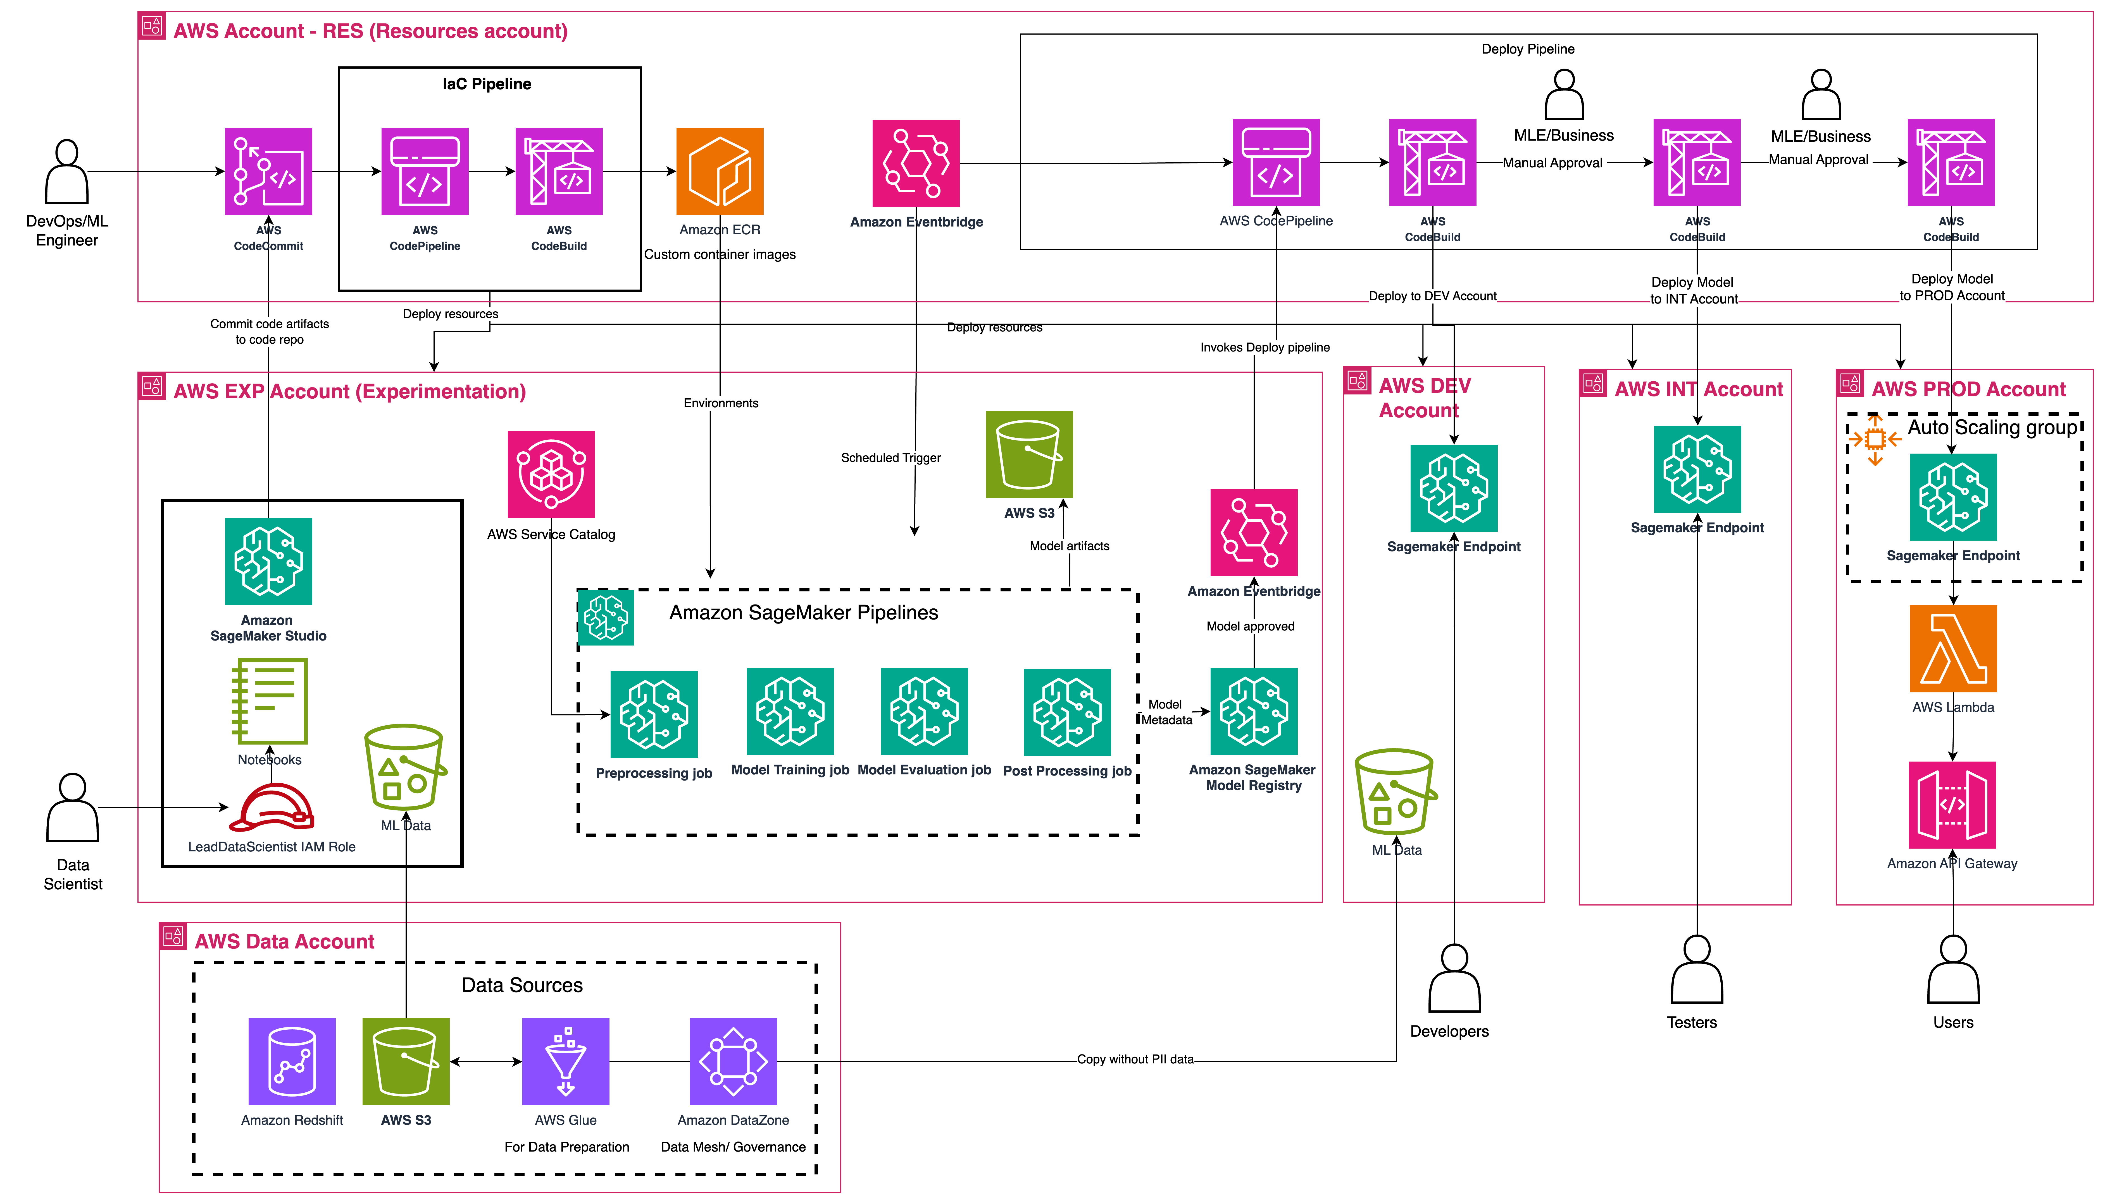
MLOps- Design

Slide 80
Optimizing and Deploying for Inference

Slide 81
Inference – Important metrics
1
Throughput = query/s
More Throughput equals more concurrent users
The higher the better
2
Latency = s/token
Low latency allows faster response
The lower the better
3
Cost
$ always matter
The lower the better
We will only focus on the decoding part of the transformer after the prefill phase.

Slide 82
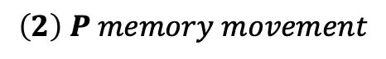
Inference – Important metrics
LLM
Size = # Parameters (P)
For one inference
Bounded by
$$\left(1\right)Floating point operations to operate= P×Batch_Size$$
Hardware Flops
$$\left(2\right) P memory movement$$
Hardware Memory Bandwidth
Time
$$Time for computation=\left(1\right)/hardaware_flops$$
$$Time to load model=\left(2\right)/hardaware_mem_bandwidth$$
Batch Size

Slide 83
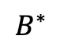
Inference – Important metrics
Time
$$Time for computation=\left(1\right)/hardaware_flops$$
$$Time to load model=\left(2\right)/hardaware_mem_bandwidth$$
$$B^{∗}$$
Batch Size
Nvidia A100 GPU
$$B^{∗}= \frac{P×Batch_size×hardaware_mem_bandwidth}{P×hardaware_flops}=\frac{hardaware_mem_bandwidth}{hardaware_flops}=\frac{321e12}{1.5e12}\sim 208 Input Sequence$$

Slide 84
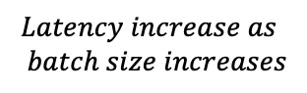
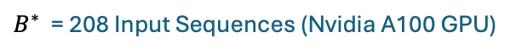
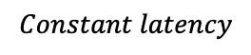
Inference – Important metrics
Time
Memory bound
Compute bound
$$Constant latency$$
$$Latency increase as \\ batch size increases$$
$$B^{∗}$$
Batch Size
$B^{∗}$: What maximizes throughput and minimize latency given a hardware
$B^{∗}$ = 208 Input Sequences (Nvidia A100 GPU)

Slide 85
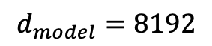
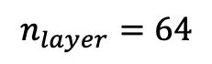
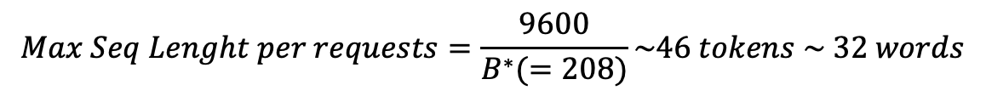
Inference – Important metrics
Two things we store in our GPUs — kv cache and weights
Size = # Parameters (P) = 10B
LLM
16fp
$$n_{layer}=64$$
Get the Max Sequence Length
$$d_{model}=8192$$
$$Bytes store in kv cache per token=2×2×n_{layer}×d_{model}$$
Nvidia A100 GPU
$$Bytes store in kv cacheper token=2,097,152=0.00209GB$$
$$Remaining Space=GPU_{space}−Model Size$$
$$Remaining Space=40GB −2×10GB=20GB$$
$$Total of tokens that can be stored=\frac{Remaining Space}{Bytes store per token}\sim 9600 tokens$$
$$Max Seq Lenght per requests=\frac{9600}{B^{∗}(=208)}\sim 46 tokens \sim 32 words$$

Slide 86
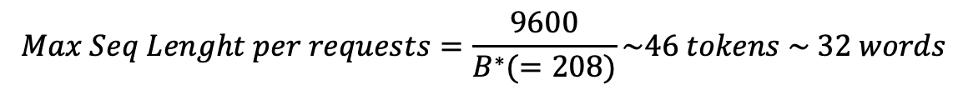
Inference – Important metrics
$$Max Seq Lenght per requests=\frac{9600}{B^{∗}(=208)}\sim 46 tokens \sim 32 words$$
At Optimal Batch Size $B^{∗}$ = 208, we can handle requests with a maximum of 46 tokens
Lower Batch Size = Higher Max Sequence Length but we will be Memory Bound
We won’t use the full capacity of the GPU Instance
More here

Slide 87
Inference – Optimization
Distillation
Quantization
Pruning
LLM
Teacher
LLM
LLM
LLM
Student
32-bit
LLM
Pruned LLM
8-bit
More here

